Slide 1
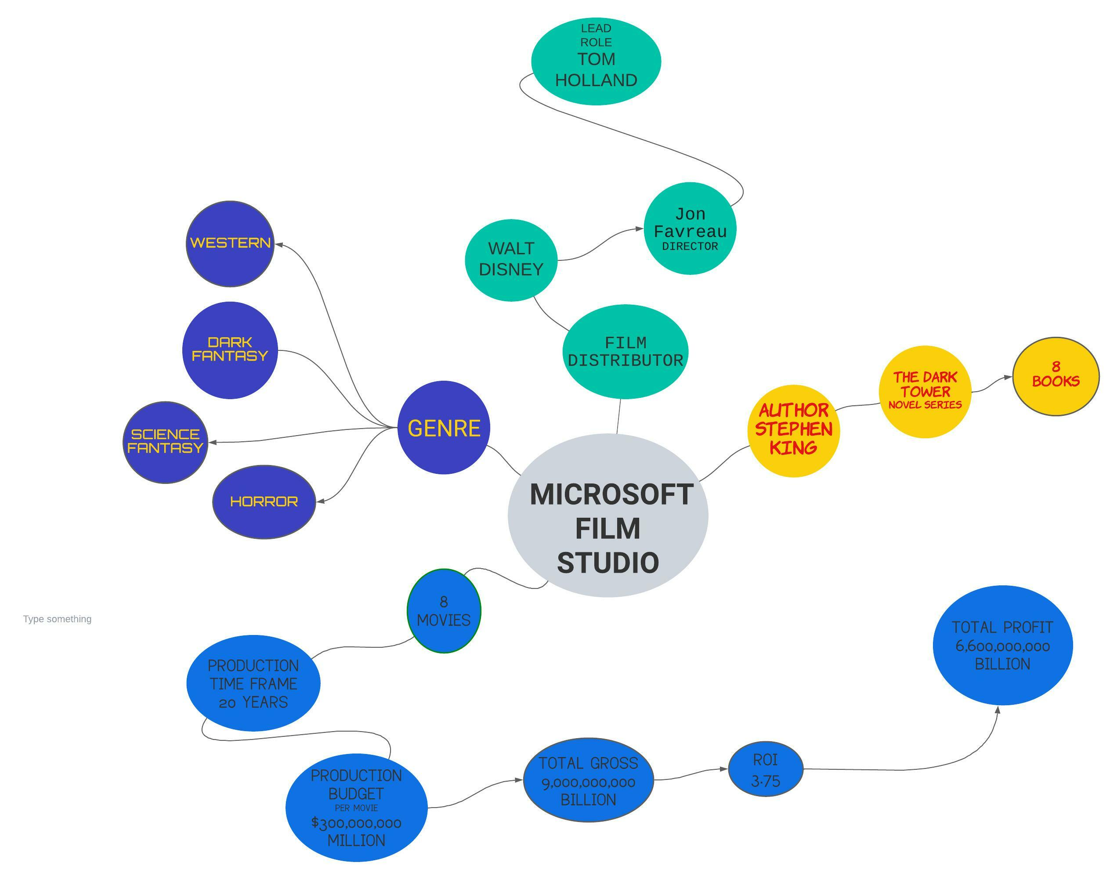

Slide 2


Microsoft Film Studio
Business plan
8-26-2022

Slide 3


TEAM
Name: Stefano Caruso
Role: Lead Data Scientist
Contact : github.com/StefanoCaruso456

Slide 4
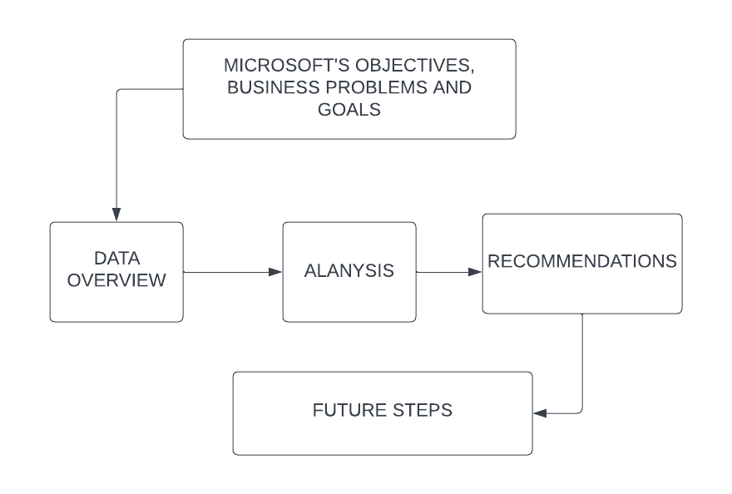
Agenda

Slide 5


My findings have revealed, film series are the key to success and longevity.

Slide 6
Business Problem
Microsoft is interested in the movie industry. Their lack of experience has led them to source out a specialist in the field. I will inform Microsoft of the proper steps and strategy while using visualization tools, looking at historic data will allow us a clear vision and path.
Creation of a film series from book novels has loyal customers already following the theme. Finding a book novel series that has yet to be created into a film with an extraordinary author, this is no easy task but will lead to a positive outcome. Becoming profitable with a reasonable production budget will be revealed in the data.
Questions being considered:
What are the top films with the most financial success?
What novel series to transform into film?
Production Budget cost ?
Lead role and film distributor?
Understand the film industry through data?

Slide 7

Data Understanding
I’ve chosen to analyze two datasets (tmdb.movies.csv.gz, tn.movie_budgets.csv.gz). After review I’ve combine them into one main data frame “Clean”. Missing data appears to be an issue and will be omitted. When encountering lack of data I will be utilizing googles resources to engineer another data frame. The most valuable dataset is “tn.movie_budgets” because it provides budget and gross revenue. The numbers resource is highly recognized for revenue across many dimensions. Combined we have over 30 thousands data points from these datasets.
The data that will lead to our conclusion is production budget, domestic gross, foreign gross, worldwide gross and top grossing series.

Slide 8
Data Overview
Data derived from The Numbers - Movie Budgets (the-numbers.com), https://www.themoviedb.org/.
Data points (30,000 movies).
LIMITATIONS: film series is necessary but based off of what novel series ?

Slide 9
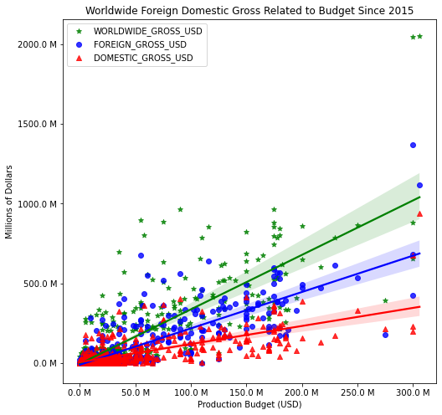
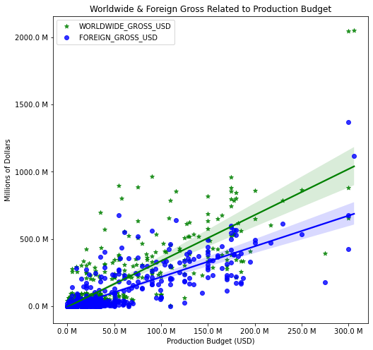
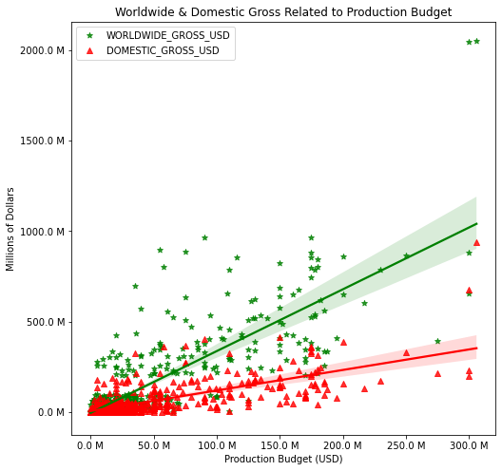
ANALYSIS
Worldwide, Domestic and Foreign Gross Correlation to Budget
Clear indication of more budget will generate larger gross. $150,000,000 is the optimization for budget.

Slide 10
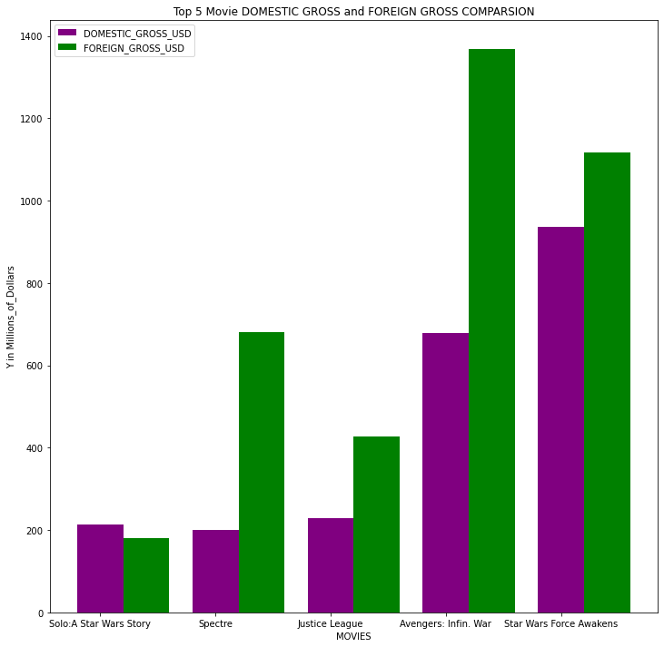
Top 5 Grossing Movie Comparison Foreign and Domestic
Foreign Gross has shown to be a larger grossing market.

Slide 11
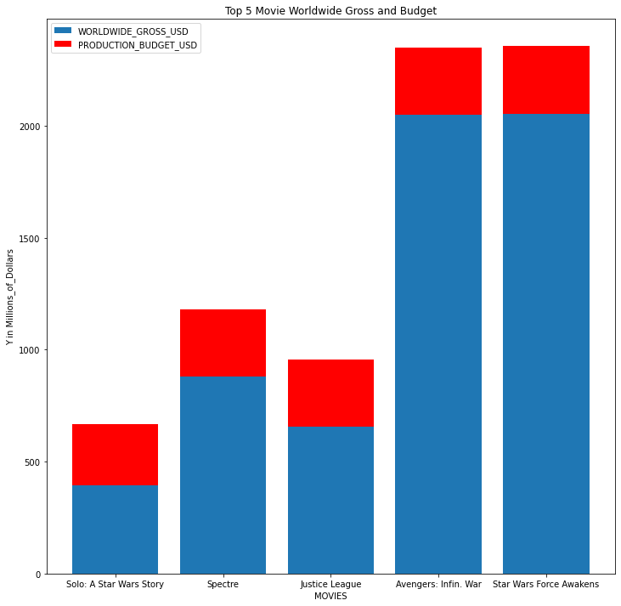
Top 5 Movies Budget and Worldwide Gross
This chart expresses the positive gap between gross and budget.

Slide 12
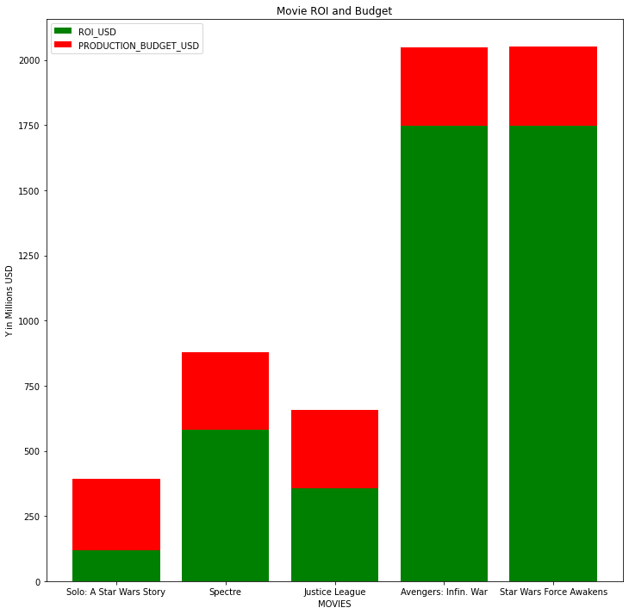
Top 5 Movies Budget and ROI in Dollars
Top 5 movies have large profits with minimal investment

Slide 13
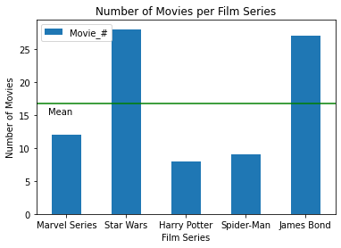
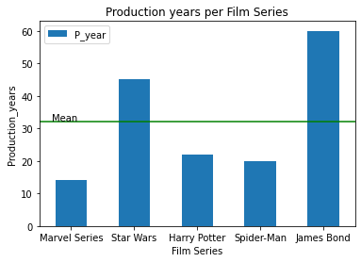
Found the top 5 film series number of movies produced, located the mean which is the sweet spot for how many films to make (16).
The mean for number of years for production is 32. This will give us a goal to produce all 16 films within 32 year.

Slide 14
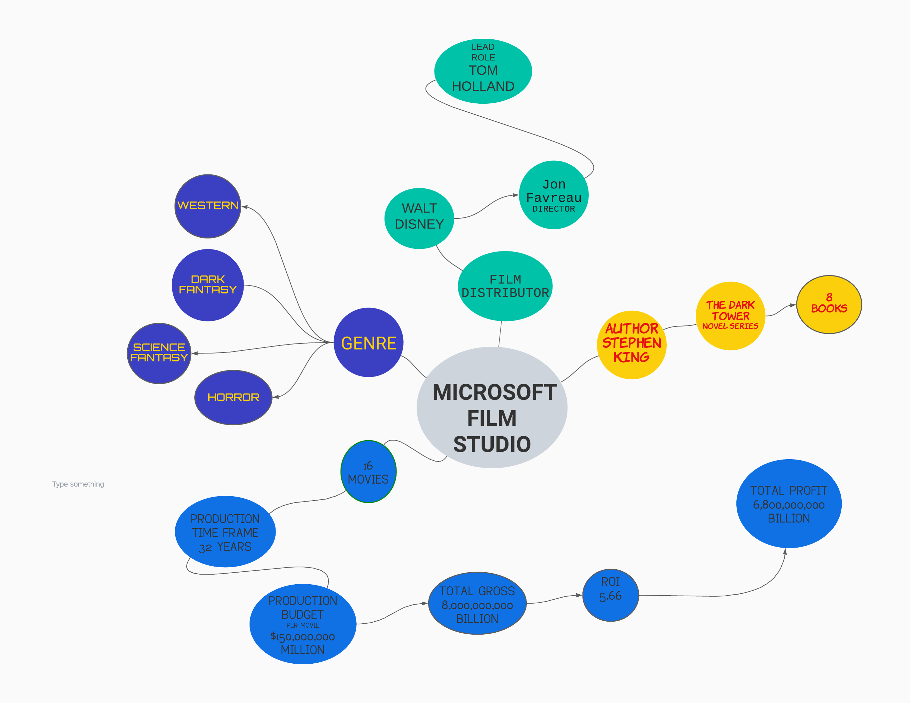
Visual Recommendation Diagram

Slide 15
The top five grossing films all have one thing in common, movie series. Creating an extremely profitable film will need a budget of $150,000,000 million. The Foreign market will be necessary to reach our revenue goal. The movie series must be based from a novel series, which has yet to be produced into a film.

